Slide 1



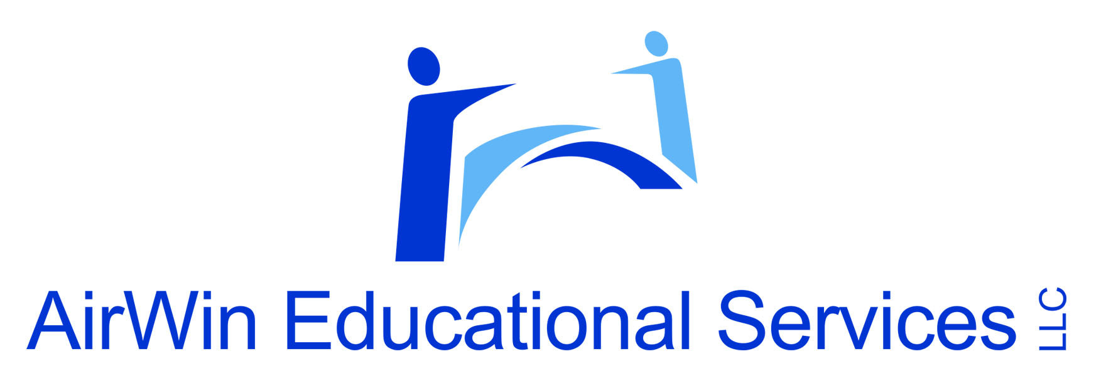

Navigating Your Role as a New Board Member:
Your Governance Compass
MCCSA Webinar Series
2026/2027
Presented by:
Angela L. Irwin, Owner
AirWin Educational Services, LLC
Notes:
Good evening everyone and welcome to the 2026/2027 virtual professional development series (explain the “theme” and the session blocks – remind them that we are in the “governance foundations” block). After explaining the “blocks,” discuss the recording of the “on-demand” announcements of upcoming blocks with brief explanations of what can be expected . . . This series is being brought to you under the “overarching” theme of the Best of Governance Series: Back by Popular Demand (Angie, explain this). REORDING – AUTHORIZER SUPPORT . . .
Now . . .thank you for your willingness to serve. Board service is a tremendous responsibility, but is also a tremendous privilege. Whether you have been on your board for three weeks or three years, this evening’s discussion is designed to help you think more intentionally about your role as a governor. Your authorizer has likely already discussed bylaws, policies, laws, compliance obligations, and board procedures. Today, I want to focus on something slightly different: how effective board members think. Think of this presentation as your governance compass!

Slide 2
FIVE QUESTIONS EVERY BOARD MEMBER SHOULD ASK
Is this aligned with our mission?
Is this within the Board’s role?
Does this support students?
Is it financially responsible?
Does it comply with our charter contract?
Notes:
Throughout our time together, I want you to keep these five questions in mind: (reveal the questions)
If you remember nothing else from today, remember these questions. They will help you navigate difficult decisions, competing priorities, and unexpected challenges.

Slide 3
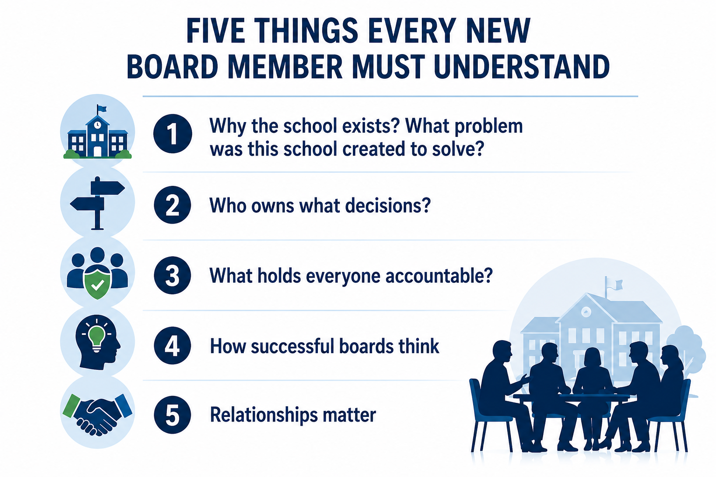
FIVE THINGS EVERY NEW BOARD MEMBER
MUST UNDERSTAND
Notes:
Today, we are going to focus on five essential ideas. These ideas are not complicated, but they are foundation. Successful board members understand why the school exists, who makes the decisions, how accountability works, how effective bords think, and why relationships matter. Everything else grows from these five ideas.

Slide 4
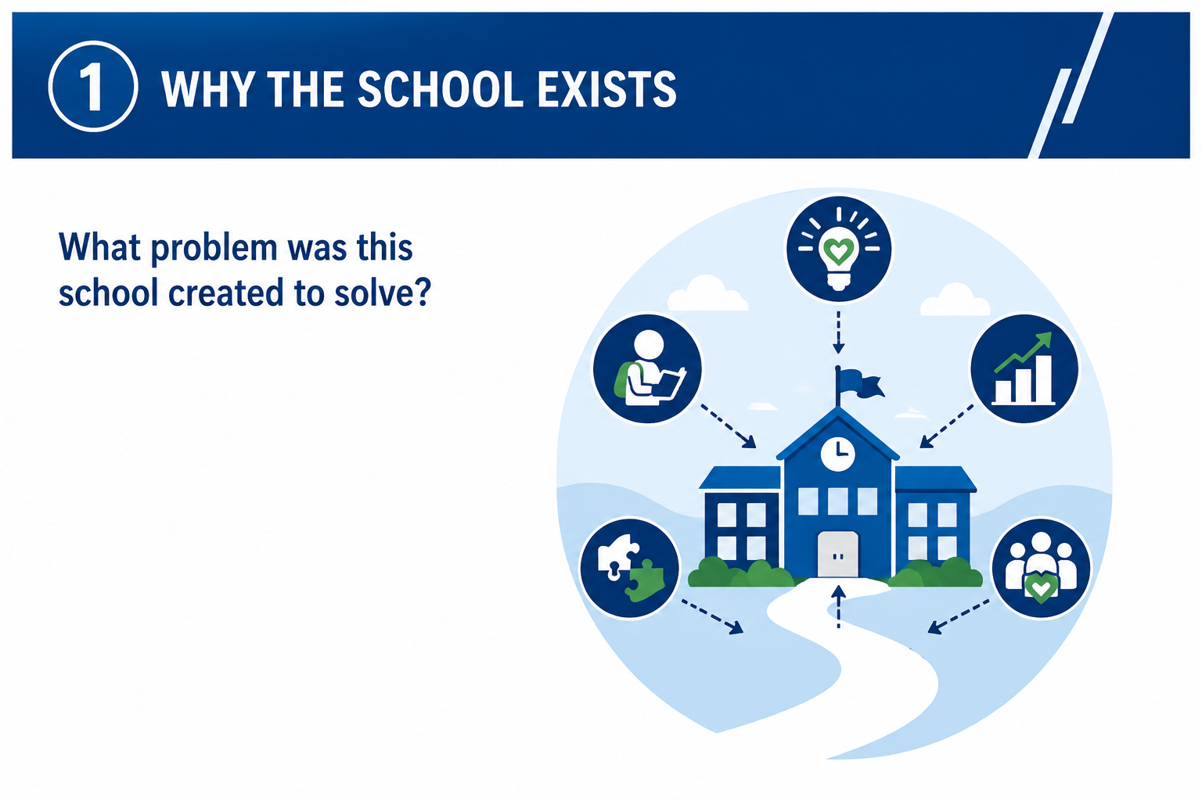
1. WHY THE SCHOOL EXISTS
Notes:
Every school was created to solve a problem, fulfill a need, or provide an opportunity. This mission is not simply a statement hanging on a wall. It is the reason the school exists. Every decision the board makes should answer a simple question: does this move us closer to fulfilling our purpose? Whenever difficult decisions arise, the mission should become your decision anchor.
What is your school’s mission? Does it continue to reflect your current existence? Is it relevant to TODAY’s problem you are trying to solve?

Slide 5
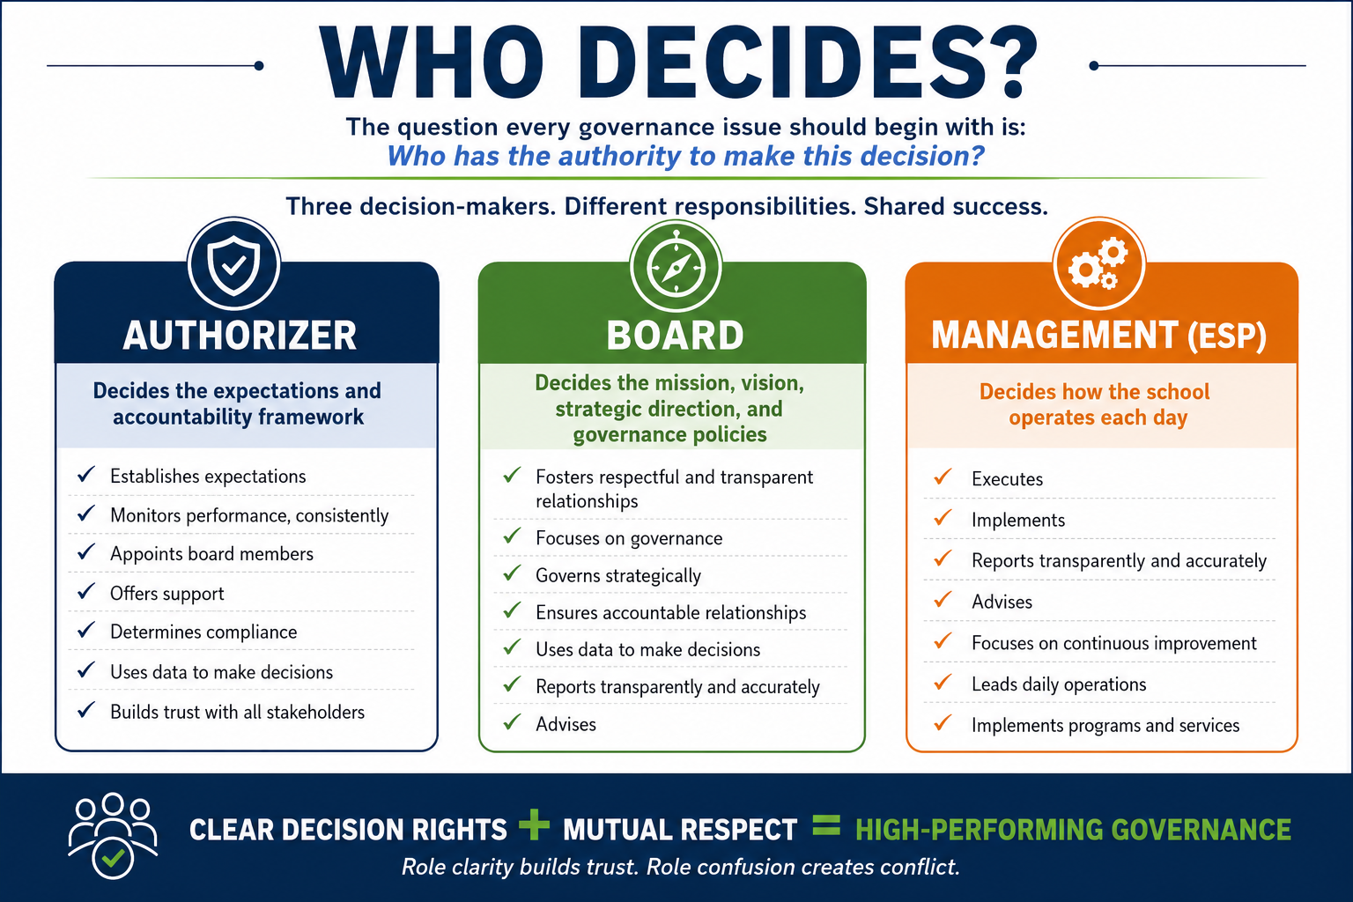
2. WHO OWNS WHAT DECISIONS
Notes:
One of the greatest sources of tension in governance is role confusion. Many problems disappear when people understand who has the authority to make a particular decision. The authorizer establishes expectations and accountability; the board establishes mission, vision, strategy and policy; management leads the daily work of the school and decides “HOW” it should be done; different responsibilities. Share success. Aand remember this important principle: individual board members have influence, but the board itself possesses the authority,
Three-legged stool: Three essential partners working together – Understand (your role relative to the two “other” legs), Commit (to performance expectations), Respect (the distinct responsibilities of each partner)

Slide 6
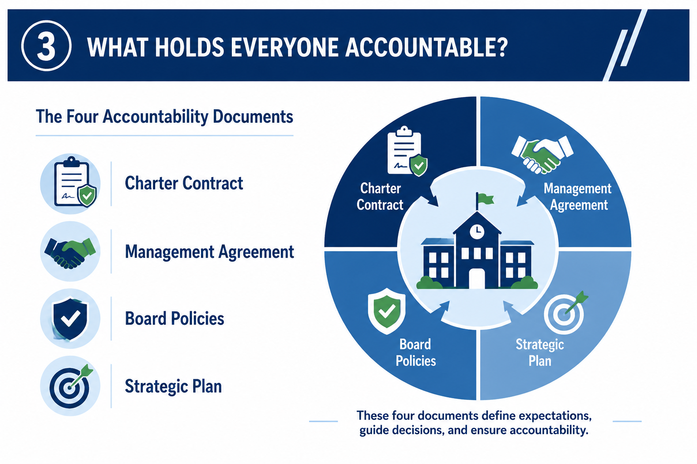
3. WHAT HOLDS EVERYONE ACCOUNTABLE?
Notes:
Successful organizations/schools create clarity. These four documents provide that clarity: (discuss the four)
Together, these documents establish expectations, define responsibilities, guide decisions, and create accountability. When questions arise, successful boards return to these documents.

Slide 7
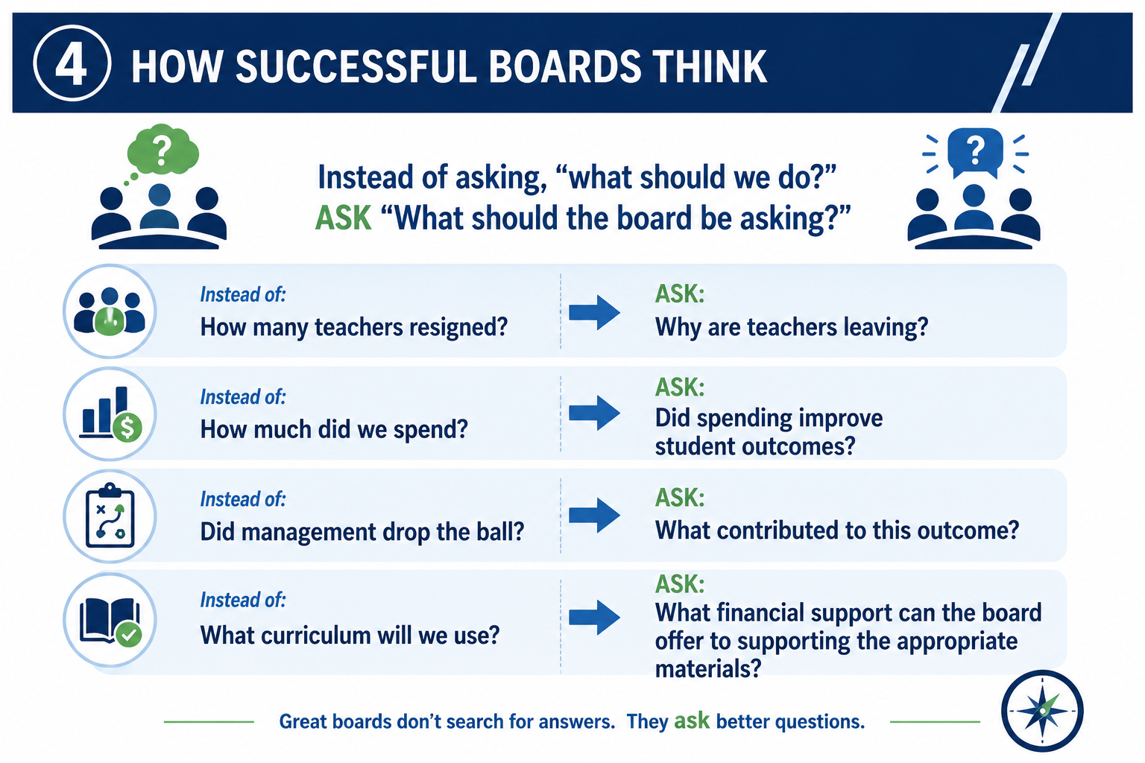
4. HOW SUCCESSFUL BOARDS THINK
Notes:
Many new board members assume that they were chosen because they have all of the answers. That is not true. You were selected because you bring wisdom, judgment, perspective and experience. Strong boards do not simply solve problems. They ask better questions! Notice the difference between operational questions and governance questions. Instead of asking who is at fault, ask what conditions produced the outcome. Instead of focusing on a single event, focus on the larger system.
Inputs (Academy Resources) + Outputs (delivery on resources) = Outcomes (impacts/changes based upon the effectiveness of the inputs and the outputs)

Slide 8
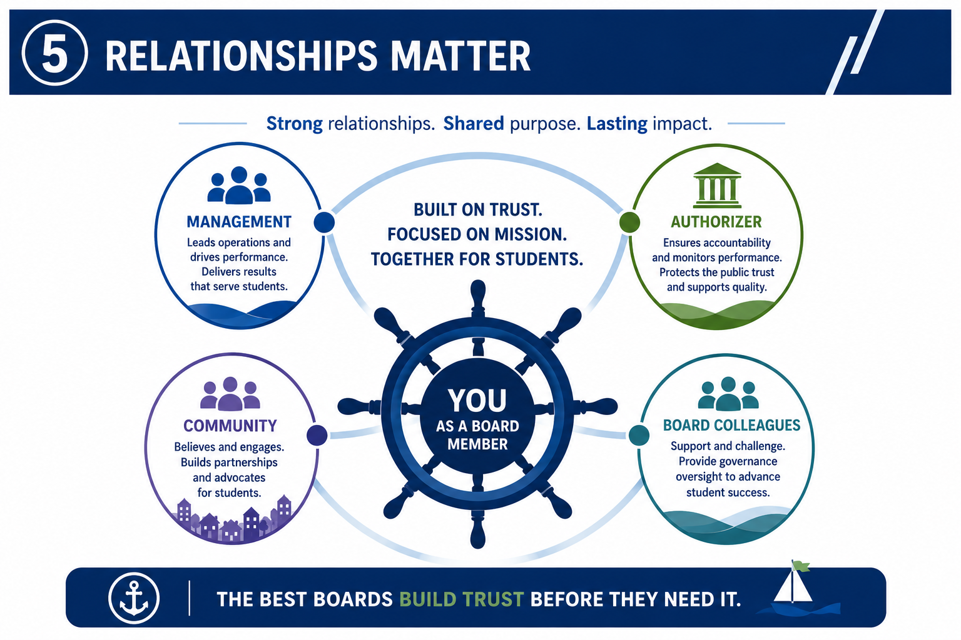
5. RELATIONSHIPS MATTER
Notes:
Governance is fundamentally about relationships. The strongest boards invest in relationships long before they encounter difficulties. Trust is not build during a crisis. Trust is built before a crisis. As a board member, you are constantly balancing relationships with management, your authorizer, your fellow board members, and the broader community. Mutual respect creates strong organizations, healthier cultures, and better outcomes for students.

Slide 9
THE GOVERNANCE MINDSET
Strong governance shifts the conversation from reacting to learning.
REACTIVE QUESTION
GOVERNANCE QUESTION
X
What happened?
✓
Why did it happen?
X
Who made the mistake?
✓
What system allowed this?
X
How do we fix today?
✓
How do we prevent it tomorrow?
Better questions keep the Board focused on patterns, systems and long-term oversight.
Notes:
Continuation of “how successful boards think” slide . . .avoid reaction – shift to “education”

Slide 10
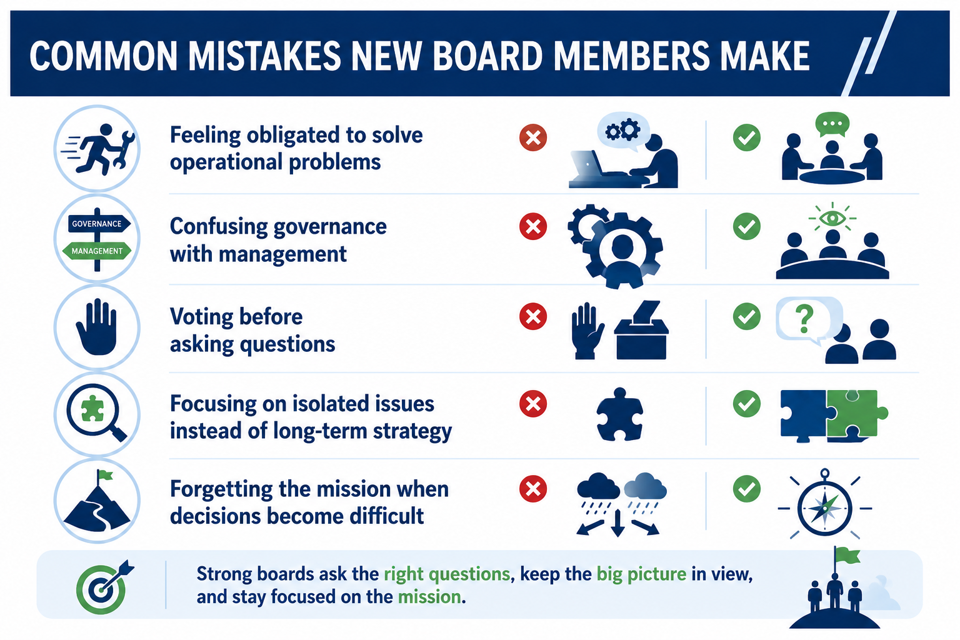
COMMON MISTAKES NEW BOARD MEMBERS MAKE
Notes:
Every board members makes mistakes! The goal is not perfection The goal is growth. New board members often try to solve operational problems, blur the lines between governance and management, move too quickly to decisions, become focused on isolated issues, or lose sight of the mission. The best boards remain disciplined, ask thoughtful questions, and maintain a long-term perspective.

Slide 11
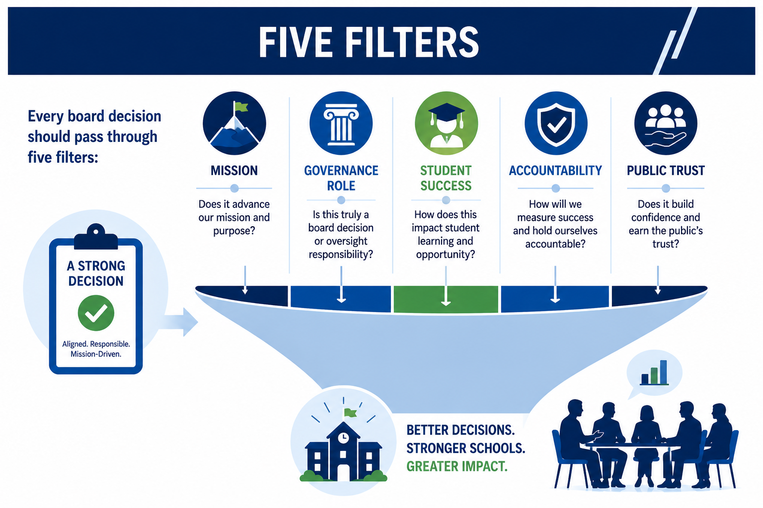
THE FIVE FILTERS
Notes:
I would encourage you to think of these five filters as your person decision-making framework. Before making any significant decision, ask yourself these questions (review the questions). If you consistently apply these filters, you will make stronger decisions and become a stronger board member.
Accountability/Public trust – represent fiduciary responsibilities, including charter contract compliance!

Slide 12
THANK YOU!
4521 Henry Drive
Beaverton, MI 48612
989.239.7555
ANGELA@AIRWINLLC.COM
Presented by:
Angela L. Irwin, Owner
AirWin Educational Services, LLC
Notes:
As we conclude, I would like to leave you with one final thought . . . You are not simply serving on a board. You are serving students, families and communities. You will not always have all the answers. None of us do. But if you remain focused on the mission, understand your role, ask thoughtful questions, build strong relationships, and protect the public trust, you will make an extraordinary difference. Thank you for your willingness to serve, and thank you for spending time with me tonight!
Next session: Tuesday, October 6th – Effective Board Leadership – President and VP Essentials - Zoom

